Slide 1



Agenda
News from the European Cluster Collaboration Platform
Perspectives from the European Commission
Bonifacio García Porras, Head of Unit SMEs, DG GROW, European Commission
Panel debate: Support for SMEs
Véronique Willems, Secretary General, SMEunited
Montserrat Daban, Cluster Director of Science Policy and Internationalisation, Biocat
Ola Svedin, President, Clusters of Sweden
Jorge Guillén, Export Manager, Agroveco Group
Funding opportunities
#EUClustersTalks

Slide 2
Agenda
News from the European Cluster Collaboration Platform
Perspectives from the European Commission
Bonifacio García Porras, Head of Unit SMEs, DG GROW, European Commission
Panel debate: Support for SMEs
Véronique Willems, Secretary General, SMEunited
Montserrat Daban, Cluster Director of Science Policy and Internationalisation, Biocat
Ola Svedin, President, Clusters of Sweden
Jorge Guillén, Export Manager, Agroveco Group
Funding opportunities
#EUClustersTalks

Slide 3
Housekeeping rules
Chris Burns, presenter
Please use the Q&A function to ask questions, and the chat function to comment or share links
Please raise your hand if you like to take the floor and unmute yourself.
If you would like to be on video, please ask us to activate your camera.
Please note that the session is being recorded.
#EUClustersTalks

Slide 4
NEWS FROM THE
EUROPEAN CLUSTER COLLABORATION PLATFORM

Slide 5
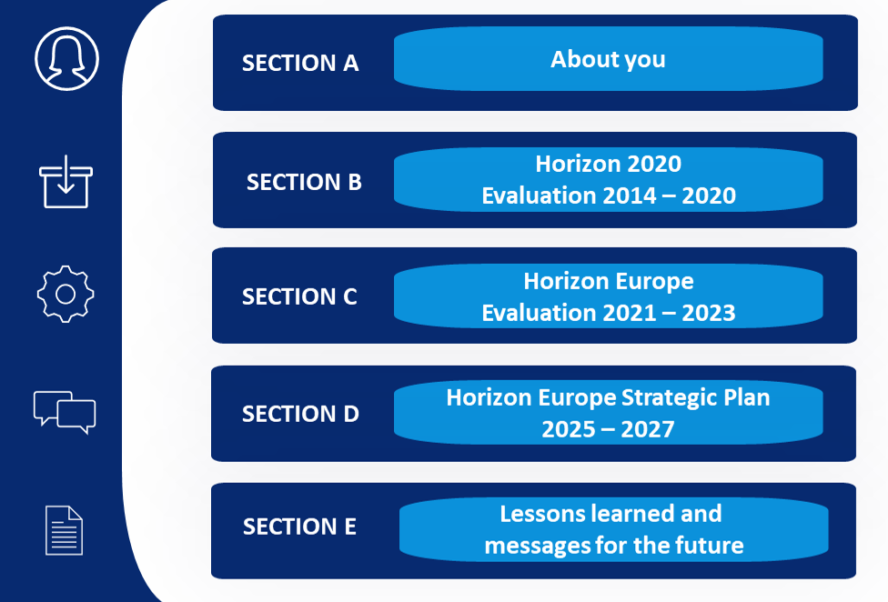
Consultation on European research and innovation programmes 2014-2027
Share views on the performance of Horizon 2020 and Horizon Europe, as well as shaping the strategic orientations for the Horizon Europe Strategic Plan 2025-2027
Consultation open until February 2023
Have your say: https://ec.europa.eu/eusurvey/runner/Horizon2020HorizonEuropeStrategicPlan2025-2027
#EUClustersTalks
Notes:
There is still a need for help. So if there are potential donors for electric generators or school buses, please inform us and the European Commission.

Slide 6

Save the date for the next C2Lab!
Lund, Sweden, on 21-22 March 2023
Interactive workshop to bring and find collaboration partners, mature your project idea, and build the business case for your idea
For cluster organisations, companies, research organisations, actors from the civil society, and other interested entities
#EUClustersTalks
Notes:
There is still a need for help. So if there are potential donors for electric generators or school buses, please inform us and the European Commission.

Slide 7

Upcoming Clusters meet Regions events
Lyon, France, 8-9 March 2023
Košice, Slovakia, 29-30 March 2023
The objective is to facilitate the implementation of good practices where clusters play an active role in regional economies and are drivers for economic transition, and to create and promote collaborations between clusters and regional stakeholders for the industrial development of the regions​.
#EUClustersTalks
Notes:
There is still a need for help. So if there are potential donors for electric generators or school buses, please inform us and the European Commission.

Slide 8
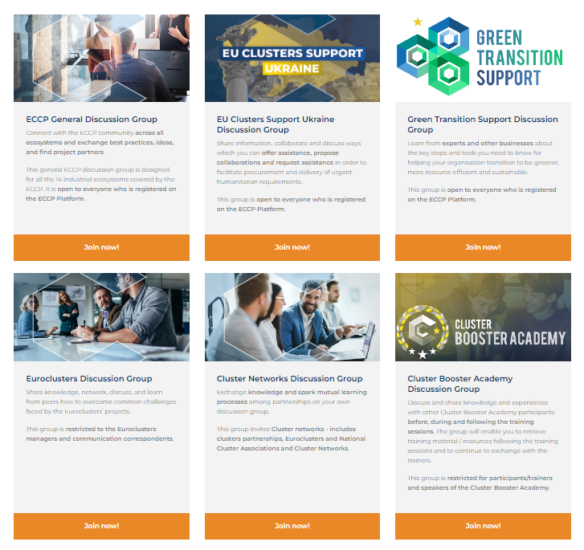

ECCP Discussion Groups on LinkedIn
#EUClustersTalks
Notes:
There is still a need for help. So if there are potential donors for electric generators or school buses, please inform us and the European Commission.

Slide 9
Bonifacio García Porras
Head of Unit SMEs at Directorate-General for Internal Market,
Industry, Entrepreneurship and SMEs (DG GROW)
European Commission

Slide 10
Panel debate
Véronique Willems, Secretary General, SMEunited
Montserrat Daban, Cluster Director of Science Policy and Internationalisation, Biocat
Ola Svedin, President, Clusters of Sweden
Jorge Guillén, Export Manager, Agroveco Group

Slide 11
FUNDING OPPORTUNITIES

Slide 12
Preparatory action for setting up joint programmes among innovation ecosystems actors
Projects are expected to contribute, among others, to the following outcomes:
  Facilitate the agreement among Member States, Associated Countries, and/or their regions, in cooperation with the private sector and research and innovation actors, towards more dynamic, inclusive, gender diverse, and connected innovation ecosystems
  Prepare joint long-term programmes and action plans fostering collaboration, common innovation-support activities, and the creation of common knowledge assets;
  Ensure the inclusion of all key innovation players from across the quadruple helix;
  Foster synergies with other EU funding programmes
Horizon Europe Framework Programme;
Topic ID: HORIZON-CL4-2023-RESILIENCE-01-42
Deadline: 23 March 2023
More info on EU Funding & Tenders Portal
#EUClustersTalks

Slide 13
Boosting generation and diffusion of advanced technologies in SMEs based on a supply chain model (CSA)
Projects are expected to contribute, among others, to the following outcomes:
  Build a model for each industrial ecosystem to identify disruptions and technological opportunities for the uptake of advanced technologies in a supply chain;
  Alert on current disruptions and identify potential future disruptions;
  Identify potential alternate suppliers of critical advanced technologies;
  Launch one pilot project per each industrial ecosystem focused on building alliances among traditional and tech-savvy SMEs through industrial cluster organisations
Horizon Europe Framework Programme;
Topic ID: HORIZON-CL4-2023-RESILIENCE-01-42
Deadline: 20 April 2023
More info on EU Funding & Tenders Portal
#EUClustersTalks

Slide 14
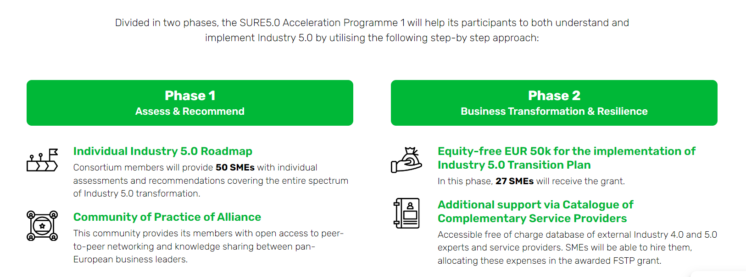
The SURE 5.0 project - Acceleration Programme 1
The SURE 5.0 project aims to support European SMEs working in the mobility, transport & automotive, aerospace and electronics European ecosystems to advance in their digital transformation process while becoming more human-centric, sustainable and resilient.
Deadline: 1 March 2023; www.sureproject.eu
#EUClustersTalks

Slide 15
GreenOffshoreTech: Making offshore production and transport green, clean and sustainable
2nd Open Call for SMEs: Innovation Projects will be selected aiming to develop new products, processes, or services for Green Offshore Production and Transport and addressing at least one of the topics:
  Advanced Materials
  Advanced Manufacturing & Digitalisation (IoT, AI, Big data)
  Environmental Technologies (Circular economy – Waste Prevention, Reuse, Recycle, Recovery)
  Green Shipping and New Energy Carriers (Hydrogen, Methanol, Ammonia, Lithium-ion Cell, LNG)
Deadline: 24 March 2023
Phase 1 (3 months): The 54 TOP ranked projects will receive a lump sum of €5,000 per project for developing a sound initial business plan that justify the feasibility of the project idea.
Phase 2 (7 months): The 26 TOP ranked projects of PHASE 1 will receive in addition a lump sum of €45,000 per project for developing a minimum viable product to validate the project idea, including its design description.
Phase 3 (2 months): The 12 TOP ranked projects of PHASE 2 will receive in addition a lump sum of €10,000 per project for activities related to promotion and exploitation of the project results.
More info on: www.greenoffshoretech.com
#EUClustersTalks

Slide 16
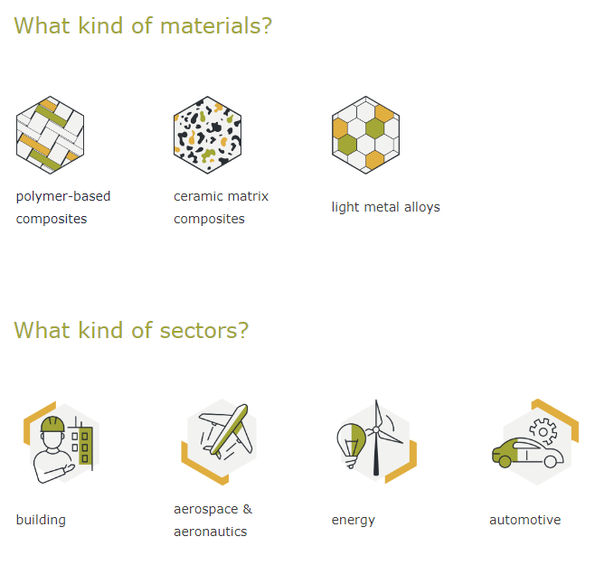
AMULET 2nd Open Call
Goal is to create new value chains through projects that will foster the penetration of advanced lightweight materials in four sectors
Deadline: 22 March 2023
Up to 26 consortia (2-3 SMEs) to submit a feasibility study:
23,000 €
Up to 7 consortia (2-3 SMEs) to demonstrate their solutions: 80,000 €
Up to 7 consortia (2-3 SMEs) to get follow-up support services: 17,000 €
More info on: www.amulet-2oc-h2020.fundingbox.com
#EUClustersTalks

Slide 17
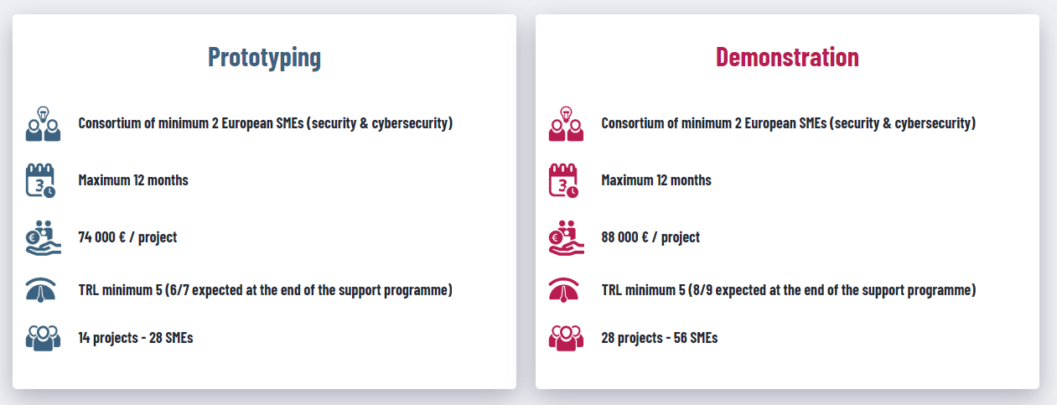
SecurIT: Critical infrastructure protection, disaster resilience and public spaces protection
SecurIT aims to increase the security of current applications, services and infrastructures by integrating state-of-the-art security solutions or processes, supporting the creation of lead markets & market incentives in Europe, following an end-user driven approach.
Deadline: 14 March 2023; www.securit-project.eu
Info sessions on 12 and 25 January; online matchmaking on 18 January and 8 February
#EUClustersTalks

Slide 18
Register for the next Talks
25 January 2023: Transition Pathway for Aerospace and Defence
8 February 2023: HERA and health emergency preparedness in Europe
22 February 2023: Transition Pathway for Mobility
#EUClustersTalks

Slide 19
We value your feedback
Please fill in the feedback survey until 16th January:
https://ec.europa.eu/eusurvey/runner/EUClustersTalks
#EUClustersTalks

Slide 20
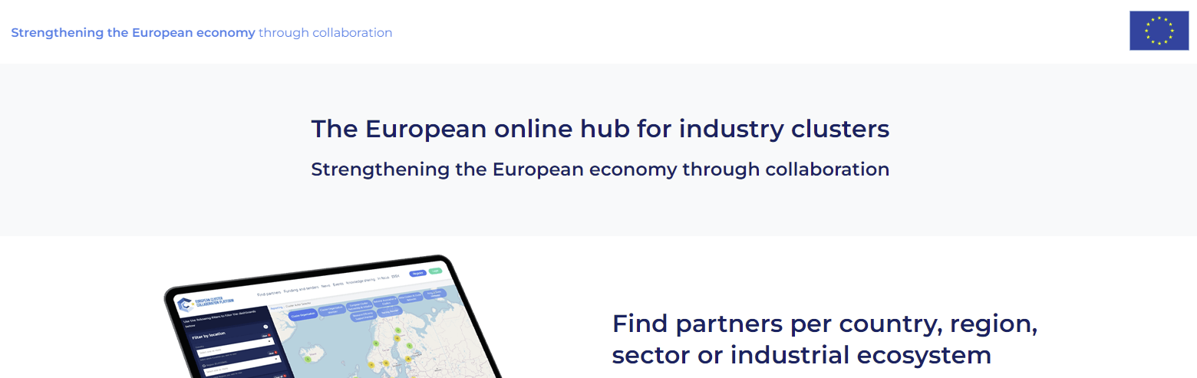
Register on the European Cluster Collaboration Platform! https://clustercollaboration.eu/
#EUClustersTalks

Slide 21
THANK YOU

