Slide 1



Holding slide with event title

Slide 2
Agenda
News from the European Cluster Collaboration Platform
From Our Own Correspondent
Perspectives from the European Commission
Giancarlo Granero, Head of Unit Coordination & Interinstitutional Relations, DG DEFIS, European Commission
Catherine Eginard, Deputy Head of Unit Coordination & Interinstitutional Relations, DG DEFIS, European Commission
Panel debate
Fabienne Daveran, Head of European Office, Aerospace Valley
Isabelle Tovena Pecault, Director Europe & International, Alpha-RLH
Krzysztof Krystowski, Managing Director, Silesian Aviation Cluster
Open round with the audience
Funding opportunities
#EUClustersTalks

Slide 3
Housekeeping rules
Chris Burns, presenter
Please use the Q&A function to ask questions, and the chat function to comment or share links
Please raise your hand if you like to take the floor and unmute yourself.
If you would like to be on video, please ask us to activate your camera.
Please note that the session is being recorded.
#EUClustersTalks

Slide 4
NEWS FROM THE
EUROPEAN CLUSTER COLLABORATION PLATFORM

Slide 5
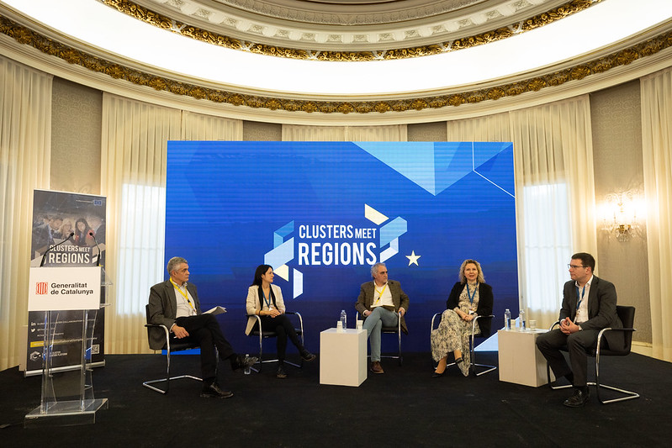
Would you like to host the next Clusters meet Regions event?
The ECCP has launched a Call for Expression of Interest to select the national/regional authorities and cluster organisations to run each of these important events.
The next deadline for making your application is 1 April 2023, 18.00 CET.
National and regional clusters and policymakers come together to share experiences, secure new partnerships and learn from one another how we can all make better use of clusters.
Check out the application process on the ECCP.
#EUClustersTalks
Notes:
There is still a need for help. So if there are potential donors for electric generators or school buses, please inform us and the European Commission.

Slide 6

Register for the next C2Lab!
Registration is open for Lund, Sweden, on 21-22 March 2023
Interactive workshop to bring and find collaboration partners, mature your project idea, and build the business case for your idea
For cluster organisations, companies, research organisations, actors from the civil society, and other interested entities
Join the C2Lab Discussion Group on LinkedIn
#EUClustersTalks
Notes:
There is still a need for help. So if there are potential donors for electric generators or school buses, please inform us and the European Commission.

Slide 7
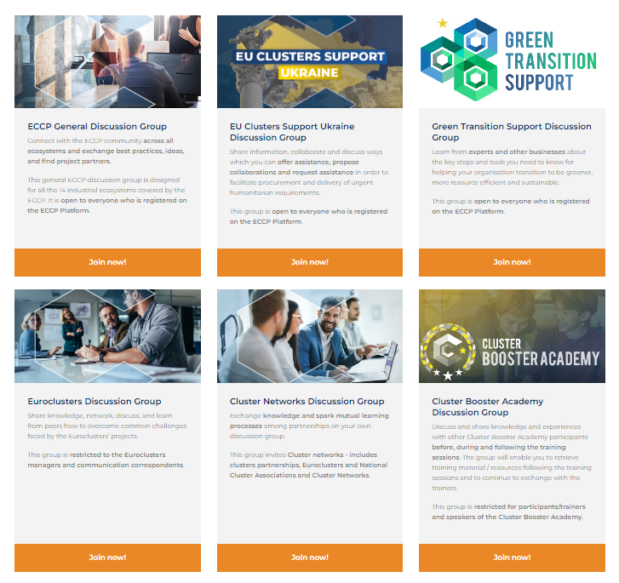
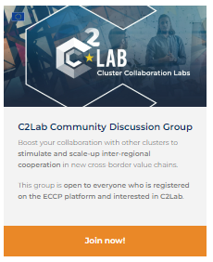
Join the ECCP Discussion Groups on LinkedIn
#EUClustersTalks
Notes:
There is still a need for help. So if there are potential donors for electric generators or school buses, please inform us and the European Commission.

Slide 8

Join the webinar on investing and doing business in Ukraine
The Enterprise Europe Network, in close collaboration with the European Commission, is inviting you to this online event on 2 February 2023, from 10:00-13:30 (CET).
The webinar targets Enterprise Europe Network advisers and cluster managers supporting business clients from all sectors of the economy.
The webinar seeks to generate commercial opportunities and to provide participants with knowledge on how to establish cooperation between European and Ukrainian companies ahead of the major reconstruction efforts.
Registration via online form
#EUClustersTalks
Notes:
There is still a need for help. So if there are potential donors for electric generators or school buses, please inform us and the European Commission.

Slide 9
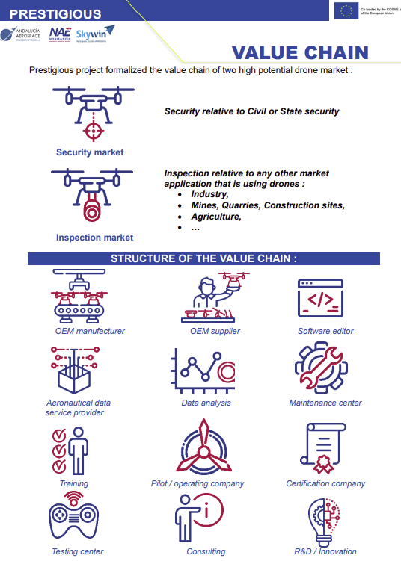
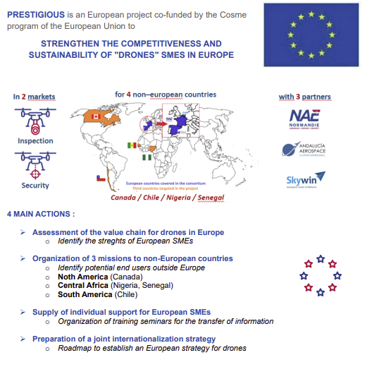
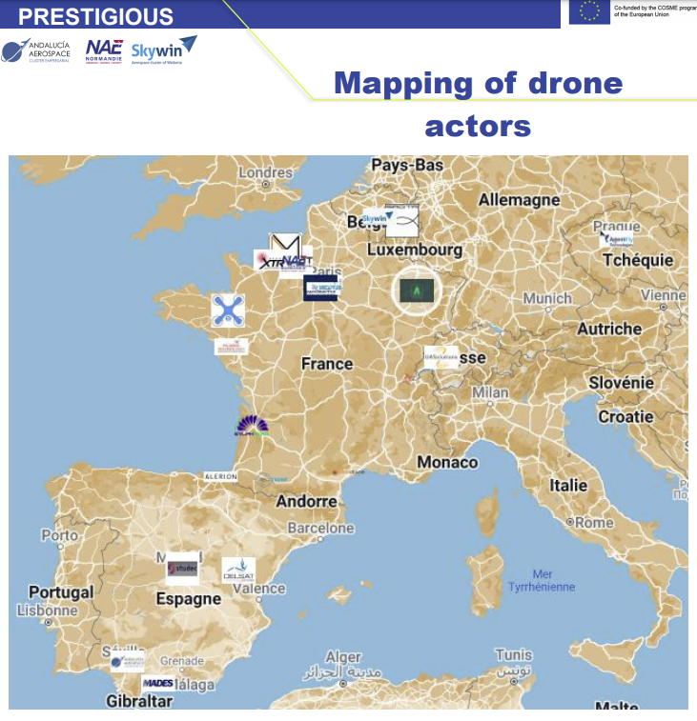
COSME project PRESTIGIOUS published mapping of drone actors in Europe
https://clustercollaboration.eu/community-news/prestigious-drones-i-techdrone
#EUClustersTalks
Notes:
There is still a need for help. So if there are potential donors for electric generators or school buses, please inform us and the European Commission.

Slide 10
FROM OUR OWN CORRESPONENT
Leviatad Eurocluster

Slide 11
Giancarlo Granero
Head of Unit Coordination & Interinstitutional Relations, DG DEFIS
European Commission

Slide 12
Catherine Eginard
Deputy Head of Unit Coordination & Interinstitutional Relations, DG DEFIS
European Commission

Slide 13
Panel debate
Fabienne Daveran, Head of European Office, Aerospace Valley
Isabelle Tovena Pecault, Director Europe & International, Alpha-RLH
Krzysztof Krystowski, Managing Director, Silesian Aviation Cluster

Slide 14
FUNDING OPPORTUNITIES

Slide 15
Alliances for Sectoral Cooperation on Skills
(implementing the ‘Blueprint')
These partnerships shall implement a coherent and comprehensive set of sectoral or cross-sectoral activities for talent and skills development, which should be adaptable to future knowledge developments across the EU.
Partners can be public or private organisations legally established in an EU Member State or third country associated to the Programme, e.g. non-governmental organisations, SMEs, sectoral or professional associations, or economic development agencies
Deadline: 3 May 2023
Erasmus+ Programme; TOPIC ID: ERASMUS-EDU-2023-PI-ALL-INNO-BLUEPRINT
Published on Funding & Tenders Portal
#EUClustersTalks

Slide 16
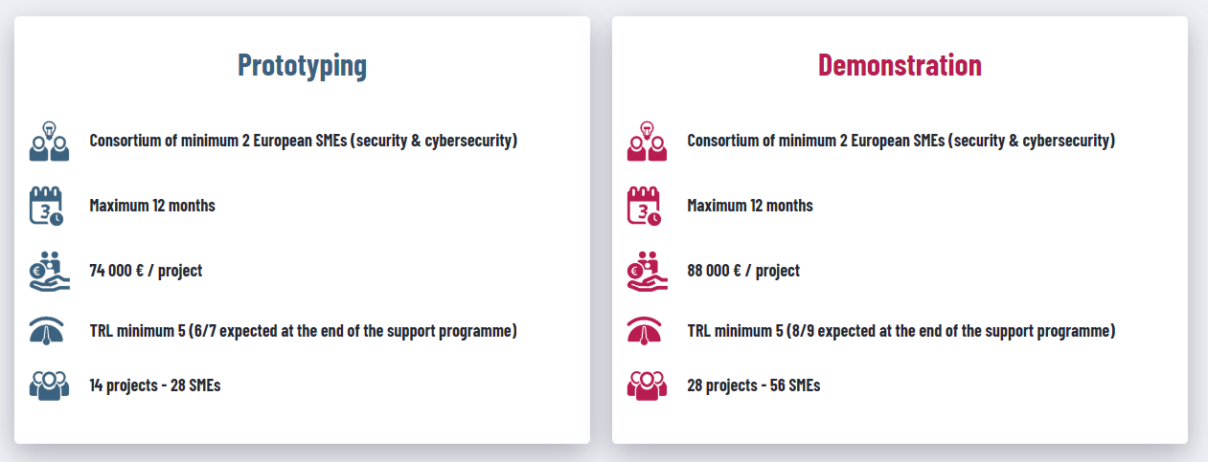
SecurIT: Critical infrastructure protection, disaster resilience and public spaces protection
SecurIT aims to increase the security of current applications, services and infrastructures by integrating state-of-the-art security solutions or processes, supporting the creation of lead markets & market incentives in Europe, following an end-user driven approach.
Deadline: 14 March 2023; www.securit-project.eu
Info sessions on 12 and 25 January; online matchmaking on 18 January and 8 February
#EUClustersTalks

Slide 17
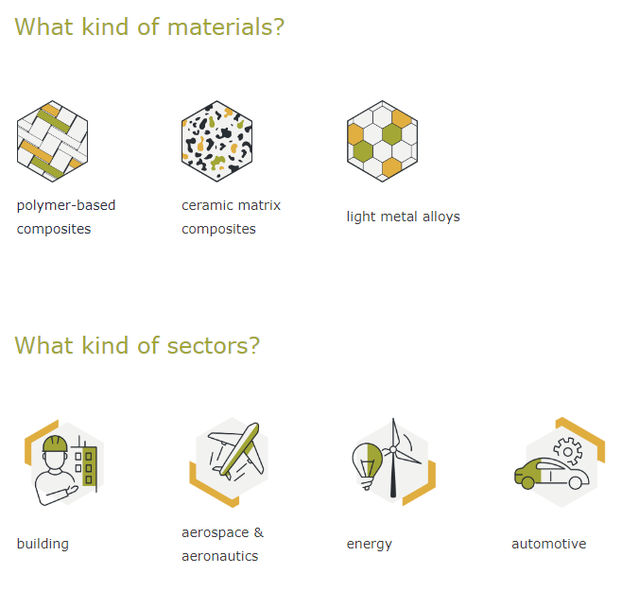
AMULET 2nd Open Call
Goal is to create new value chains through projects that will foster the penetration of advanced lightweight materials in four sectors
Deadline: 22 March 2023
Up to 26 consortia (2-3 SMEs) to submit a feasibility study:
23,000 €
Up to 7 consortia (2-3 SMEs) to demonstrate their solutions: 80,000 €
Up to 7 consortia (2-3 SMEs) to get follow-up support services: 17,000 €
More info on: www.amulet-2oc-h2020.fundingbox.com
#EUClustersTalks

Slide 18
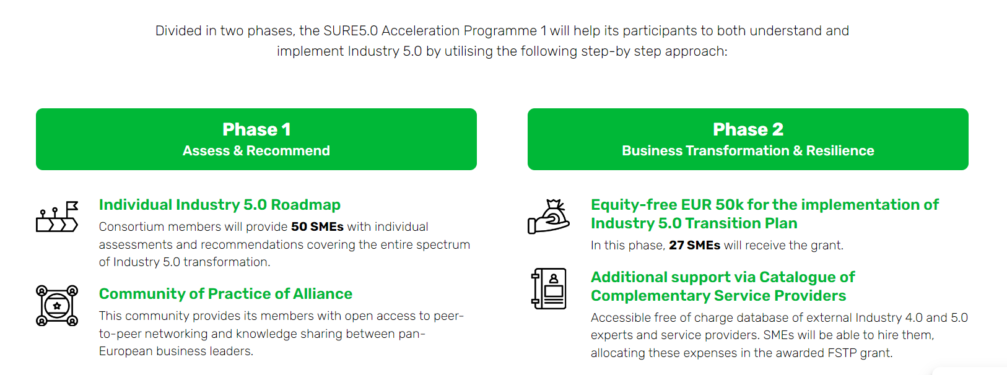
The SURE 5.0 project - Acceleration Programme 1
The SURE 5.0 project aims to support European SMEs working in the mobility, transport & automotive, aerospace and electronics European ecosystems to advance in their digital transformation process while becoming more human-centric, sustainable and resilient.
Deadline: 1 March 2023; www.sureproject.eu
#EUClustersTalks

Slide 19
Register for the next Talks
8 February 2023: Health in Europe – where does our ecosystem stand?
22 February 2023: Transition Pathway for Mobility
8 March 2023: Euroclusters
#EUClustersTalks

Slide 20
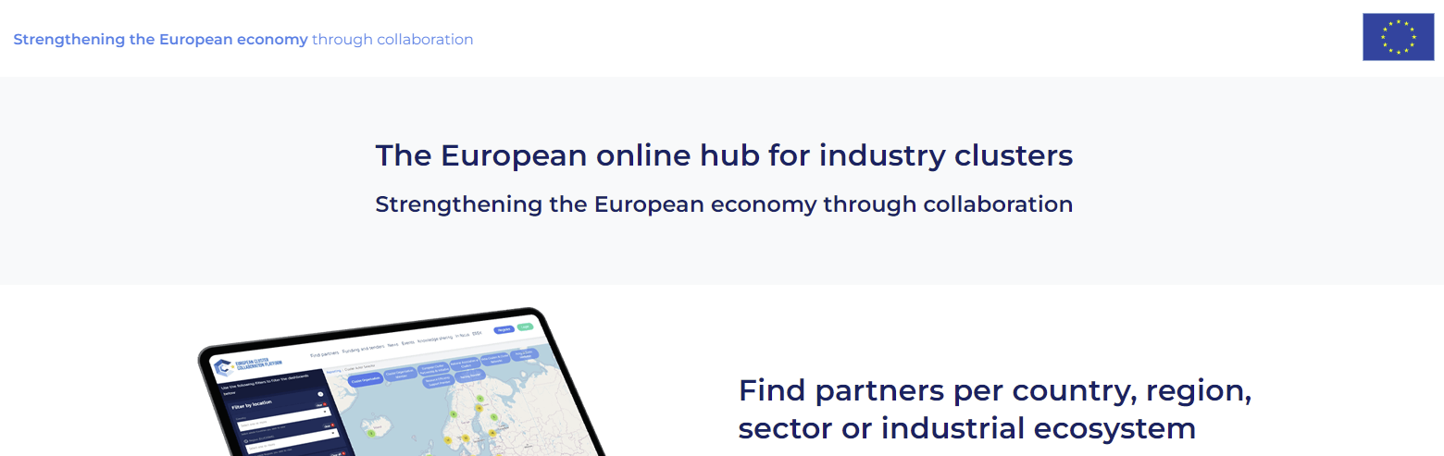
Register on the European Cluster Collaboration Platform! https://clustercollaboration.eu/
#EUClustersTalks

Slide 21
THANK YOU

